Slide 1


KS4 Mathematics
N2 Standard Form

Slide 2

Powers of ten
Our decimal number system is based on powers of ten.
We can write powers of ten using index notation.
10 = 10¹
100 = 10 × 10 = 10²
1000 = 10 × 10 × 10 = 10³
10 000 = 10 × 10 × 10 × 10 = 10⁴
100 000 = 10 × 10 × 10 × 10 × 10 = 10⁵
1 000 000 = 10 × 10 × 10 × 10 × 10 × 10 = 10⁶ …
Notes:
Discuss the use of index notation to describe numbers like 10, 100 and 1000 as powers of 10. Be aware that pupils often confuse powers with multiples and reinforce the idea of a power as a number, in this case 10, repeatedly multiplied by itself.
Make sure that pupils know that 10³, for example, is said as “ten to the power of three”.
Explain that the index tells us how many 0s will follow the 1 (this is only true for positive integer powers of ten).

Slide 3
Negative powers of ten
Any number raised to the power of 0 is 1, so
1 = 10⁰
Decimals can be written using negative powers of ten
1
1
0.1 = = =10⁻¹
10
10¹
1
1
0.01 = = = 10⁻²
100
10²
1
1
0.001 = = = 10⁻³
1000
10³
1
1
0.0001 = = = 10⁻⁴
10000
10⁴
1
1
0.00001 = = = 10⁻⁵
100000
10⁵
1
1
0.000001 = = = 10⁻⁶ …
1000000
10⁶
Notes:
Talk through the use of negative integers to represent decimals. This is discussed in the context of the place value system in N4.1 Decimals and place value.

Slide 4
Very large numbers
Use you calculator to work out the answer to
40 000 000 × 50 000 000.
Your calculator may display the answer as:
2
15
,
2
15
or
2
15
×10
E
What does the 15 mean?
The 15 means that the answer is 2 followed by 15 zeros or:
2 × 10¹⁵
= 2 000 000 000 000 000
Notes:
Different models of calculator may show the answer in different ways. Many will leave out the ×10 and will have EXP before the power or nothing at all.
Discuss how many zeros there will be in the answer. 4 × 5 is 20. There are 7 zeros in 40 000 000 and 7 zeros in 50 000 000. That means that the answer will have 14 zeros plus the zero from the 20, making 15 zeros altogether.

Slide 5
Very small numbers
Use you calculator to work out the answer to
0.0002 ÷ 30 000 000.
Your calculator may display the answer as:
1.5
–12
,
1.5
–12
or
1.5
–12
×10
E
What does the –12 mean?
The –12 means that the 15 is divided by 1 followed by 12 zeros.
1.5 × 10⁻¹²
= 0.000000000002
Notes:
Point out that if we include the 0 before the decimal point the answer has 12 zeros altogether.

Slide 6
Standard form
2 × 10¹⁵ and 1.5 × 10⁻¹² are examples of a number written in standard form.
Numbers written in standard form have two parts:
A number between 1 and 10
A power of 10
×
This way of writing a number is also called standard index form or scientific notation.
Any number can be written using standard form, however it is usually used to write very large or very small numbers.
Notes:
Point out that the numbers between 1 and 10 do not include the number 10.

Slide 7
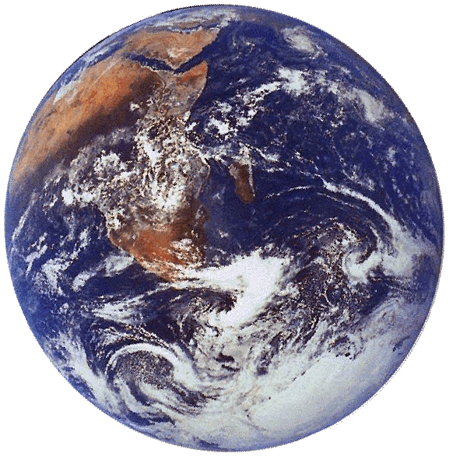
Standard form – writing large numbers
For example, the mass of the planet earth is about
5 970 000 000 000 000 000 000 000 kg.
We can write this in standard form as a number between 1 and 10 multiplied by a power of 10.
5.97 × 10²⁴ kg
A number between 1 and 10
A power of ten

Slide 8
Standard form – writing large numbers
How can we write these numbers in standard form?
80 000 000 =
8 × 10⁷
230 000 000 =
2.3 × 10⁸
724 000 =
7.24 × 10⁵
6 003 000 000 =
6.003 × 10⁹
371.45 =
3.7145 × 10²
Notes:
Discuss how each number should be written in standard form.
Notice that for large numbers the power of ten will always be one less than the number of digits in the whole part of the number.

Slide 9
Standard form – writing large numbers
These numbers are written in standard form. How can they be written as ordinary numbers?
5 × 10¹⁰ =
50 000 000 000
7.1 × 10⁶ =
7 100 000
4.208 × 10¹¹ =
420 800 000 000
2.168 × 10⁷ =
21 680 000
6.7645 × 10³ =
6764.5
Notes:
Discuss how each number written in standard form should be written in full.

Slide 10
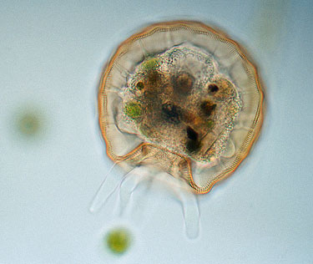
Standard form – writing small numbers
We can write very small numbers using negative powers of ten.
For example, the width of this shelled amoeba is 0.00013 m.
We write this in standard form as:
1.3 × 10⁻⁴ m.
A number between 1 and 10
A negative power of 10
Notes:
The image of a shelled amoeba has been reproduced with the kind permission of Wim van Egmond © Microscopy UK http://www.microscopy-uk.org.uk/index.html

Slide 11
Standard form – writing small numbers
How can we write these numbers in standard form?
0.0006 =
6 × 10⁻⁴
0.00000072 =
7.2 × 10⁻⁷
0.0000502 =
5.02 × 10⁻⁵
0.0000000329 =
3.29 × 10⁻⁸
0.001008 =
1.008 × 10⁻³
Notes:
Notice that the power of ten is always minus the number of zeros before the first significant figure including the one before the decimal point..

Slide 12
Standard form – writing small numbers
These numbers are written in standard form. How can they be written as ordinary numbers?
8 × 10⁻⁴ =
0.0008
2.6 × 10⁻⁶ =
0.0000026
9.108 × 10⁻⁸ =
0.00000009108
7.329 × 10⁻⁵ =
0.00007329
8.4542 × 10⁻² =
0.084542
Notes:
Again, notice that the power of ten tells us the number of zeros before the first significant figure including the one before the decimal point.

Slide 13
Ordering numbers in standard form
Write these numbers in order from smallest to largest:
5.3 × 10⁻⁴, 6.8 × 10⁻⁵, 4.7 × 10⁻³, 1.5 × 10⁻⁴.
To order numbers that are written in standard form start by comparing the powers of 10.
Remember, 10⁻⁵ is smaller than 10⁻⁴. That means that 6.8 × 10⁻⁵ is the smallest number in the list.
When two or more numbers have the same power of ten we can compare the number parts. 5.3 × 10⁻⁴ is larger than
1.5 × 10⁻⁴ so the correct order is:
6.8 × 10⁻⁵, 1.5 × 10⁻⁴, 5.3 × 10⁻⁴, 4.7 × 10⁻³

Slide 14
Calculations involving standard form
What is 2 × 10⁵ multiplied by 7.2 × 10³ ?
To multiply these numbers together we can multiply the number parts together and then the powers of ten together.
2 × 10⁵ × 7.2 × 10³ =
(2 × 7.2) × (10⁵ × 10³)
= 14.4 × 10⁸
This answer is not in standard form and must be converted!
14.4 × 10⁸ =
1.44 × 10 × 10⁸
= 1.44 × 10⁹
Notes:
Remind pupils that indices are added when we multiply.
Point out that 14.4 × 10⁸ is not in standard form and discuss how it can be converted into the correct form.

Slide 15
Calculations involving standard form
What is 1.2 × 10⁻⁶ divided by 4.8 × 10⁷ ?
To divide these numbers we can divide the number parts and then divide the powers of ten.
(1.2 × 10⁻⁶) ÷ (4.8 × 10⁷) =
(1.2 ÷ 4.8) × (10⁻⁶ ÷ 10⁷)
= 0.25 × 10⁻¹³
This answer is not in standard form and must be converted.
0.25 × 10⁻¹³ =
2.5 × 10⁻¹ × 10⁻¹³
= 2.5 × 10⁻¹⁴
Notes:
Remind pupils that indices are subtracted when we divide. Discuss how 0.25 × 10⁻¹³ can be converted into the correct form.

Slide 16
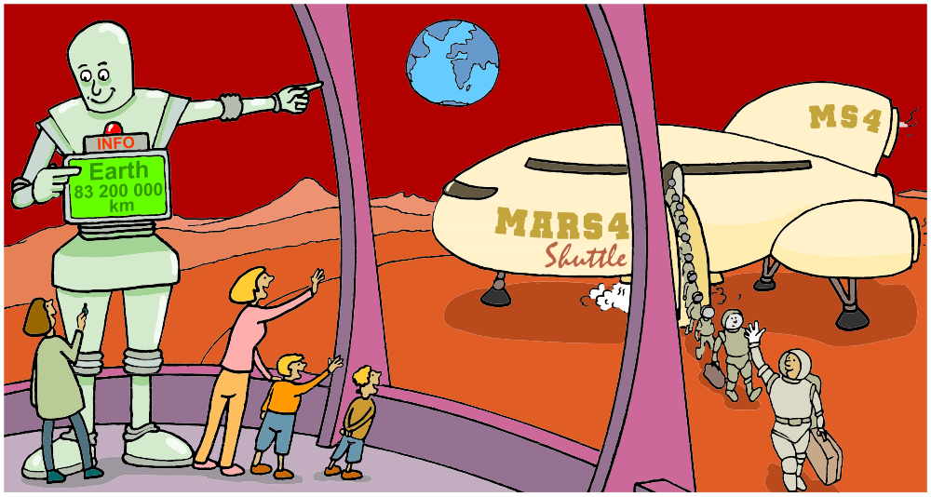
Traveling to Mars
How long would it take a space ship travelling at an average speed of 2.6 × 10³ km/h to reach Mars 8.32 × 10⁷ km away?

Slide 17
Calculations involving standard form
How long would it take a space ship travelling at an average speed of 2.6 × 10³ km/h to reach Mars 8.32 × 10⁷ km away?
distance
distance
Rearrange
speed =
to give
time =
time
speed
8.32 × 10⁷
Time to reach Mars =
2.6 × 10³
= 3.2 × 10⁴ hours
This is 8.32 ÷ 2.6
This is
10⁷ ÷ 10³
Notes:
Remind pupils that 10⁷ ÷ 10³ = 10⁴ because the indices are subtracted when dividing.

Slide 18

Calculations involving standard form
Use your calculator to work out how long 3.2 × 10⁴ hours is in years.
You can enter 3.2 × 10⁴ into your calculator using the EXP key:
3
.
2
EXP
4
Divide by 24 to give the equivalent number of days.
Divide by 365 to give the equivalent number of years.
3.2 × 10⁴ hours is over 3½ years.
Notes:
Make sure that pupils are able to enter numbers given in standard form into their calculators.

